Slide 1
Active Learning
Fine-tuning Convolutional Neural Networks for Biomedical Image Analysis: Actively and Incrementally
-Yunong He

Slide 2
Motivation:“ How to Cut Annotation Cost? ”
Annotating biomedical images is very challenging.
It is not only tedious and time consuming, but also demanding of costly, specialty-oriented knowledge and skills, which are not easily accessible.
How to dramatically reduce the cost of annotation when applying CNNs in biomedical imaging?

Slide 3
Overview:
Key Ideas:
1. Active Selection
2. Handling noisy labels
3. Continuous fine-tuning
Three applications:
1. Colonoscopy frame classification
2. Polyp detection
3. Pulmonary embolism (PE) detection
Conclusion:
The cost of annotation can be cut by at least half.
The method can cut the annotation cost by >95% relative to training from scratch; >93% relative to full fine-tuning; and >60% relative to random selection.
Notes:
1. Active selection: consistency among the patches generated from a candidate.
2. Handling noisy labels: majority selection.
3. Continuous fine-tuning: fine-tuning the fine-tuned CNN.

Slide 4
Method:
A novel method called AIFT (active, incremental fine-tuning) to naturally integrate active learning and transfer learning into a single framework.
AIFT starts directly with a pre-trained CNN to seek “worthy” samples from the unannotated for annotation, and the (fine-tuned) CNN is further fine-tuned continuously by incorporating newly annotated samples in each iteration to enhance the CNN’s performance incrementally.

Slide 5
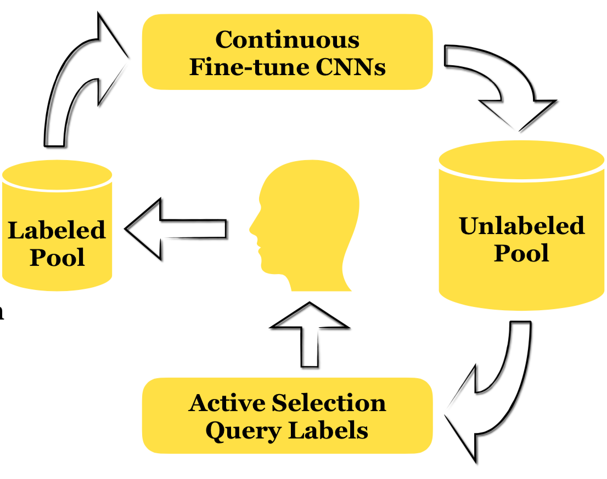

Slide 6
Observation:
To boost the performance of CNNs in biomedical imaging, multiple patches are usually generated automatically for each candidate through data augmentation;
These patches generated from the same candidate share the same label, and are naturally expected to have similar predictions by the current CNN before they are expanded into the training dataset.
As a result, their entropy and diversity provide a useful indicator to the “power” of a candidate in elevating the performance of the current CNN.
However, automatic data augmentation inevitably generates “hard” samples for some candidates, injecting noisy labels;
we compute entropy and diversity by selecting only a portion of the patches of each candidate according to the predictions by the current CNN.
Notes:
entropy captures the classification certainty—higher uncertainty values denote higher degrees of information;
diversity indicates the prediction consistency among the patches within a candidate—higher diversity values denote higher degrees of prediction inconsistency among the patches within a candidate.
Therefore, candidates with higher entropy and higher diversity are expected to contribute more in elevating the current CNN’s performance.

Slide 7
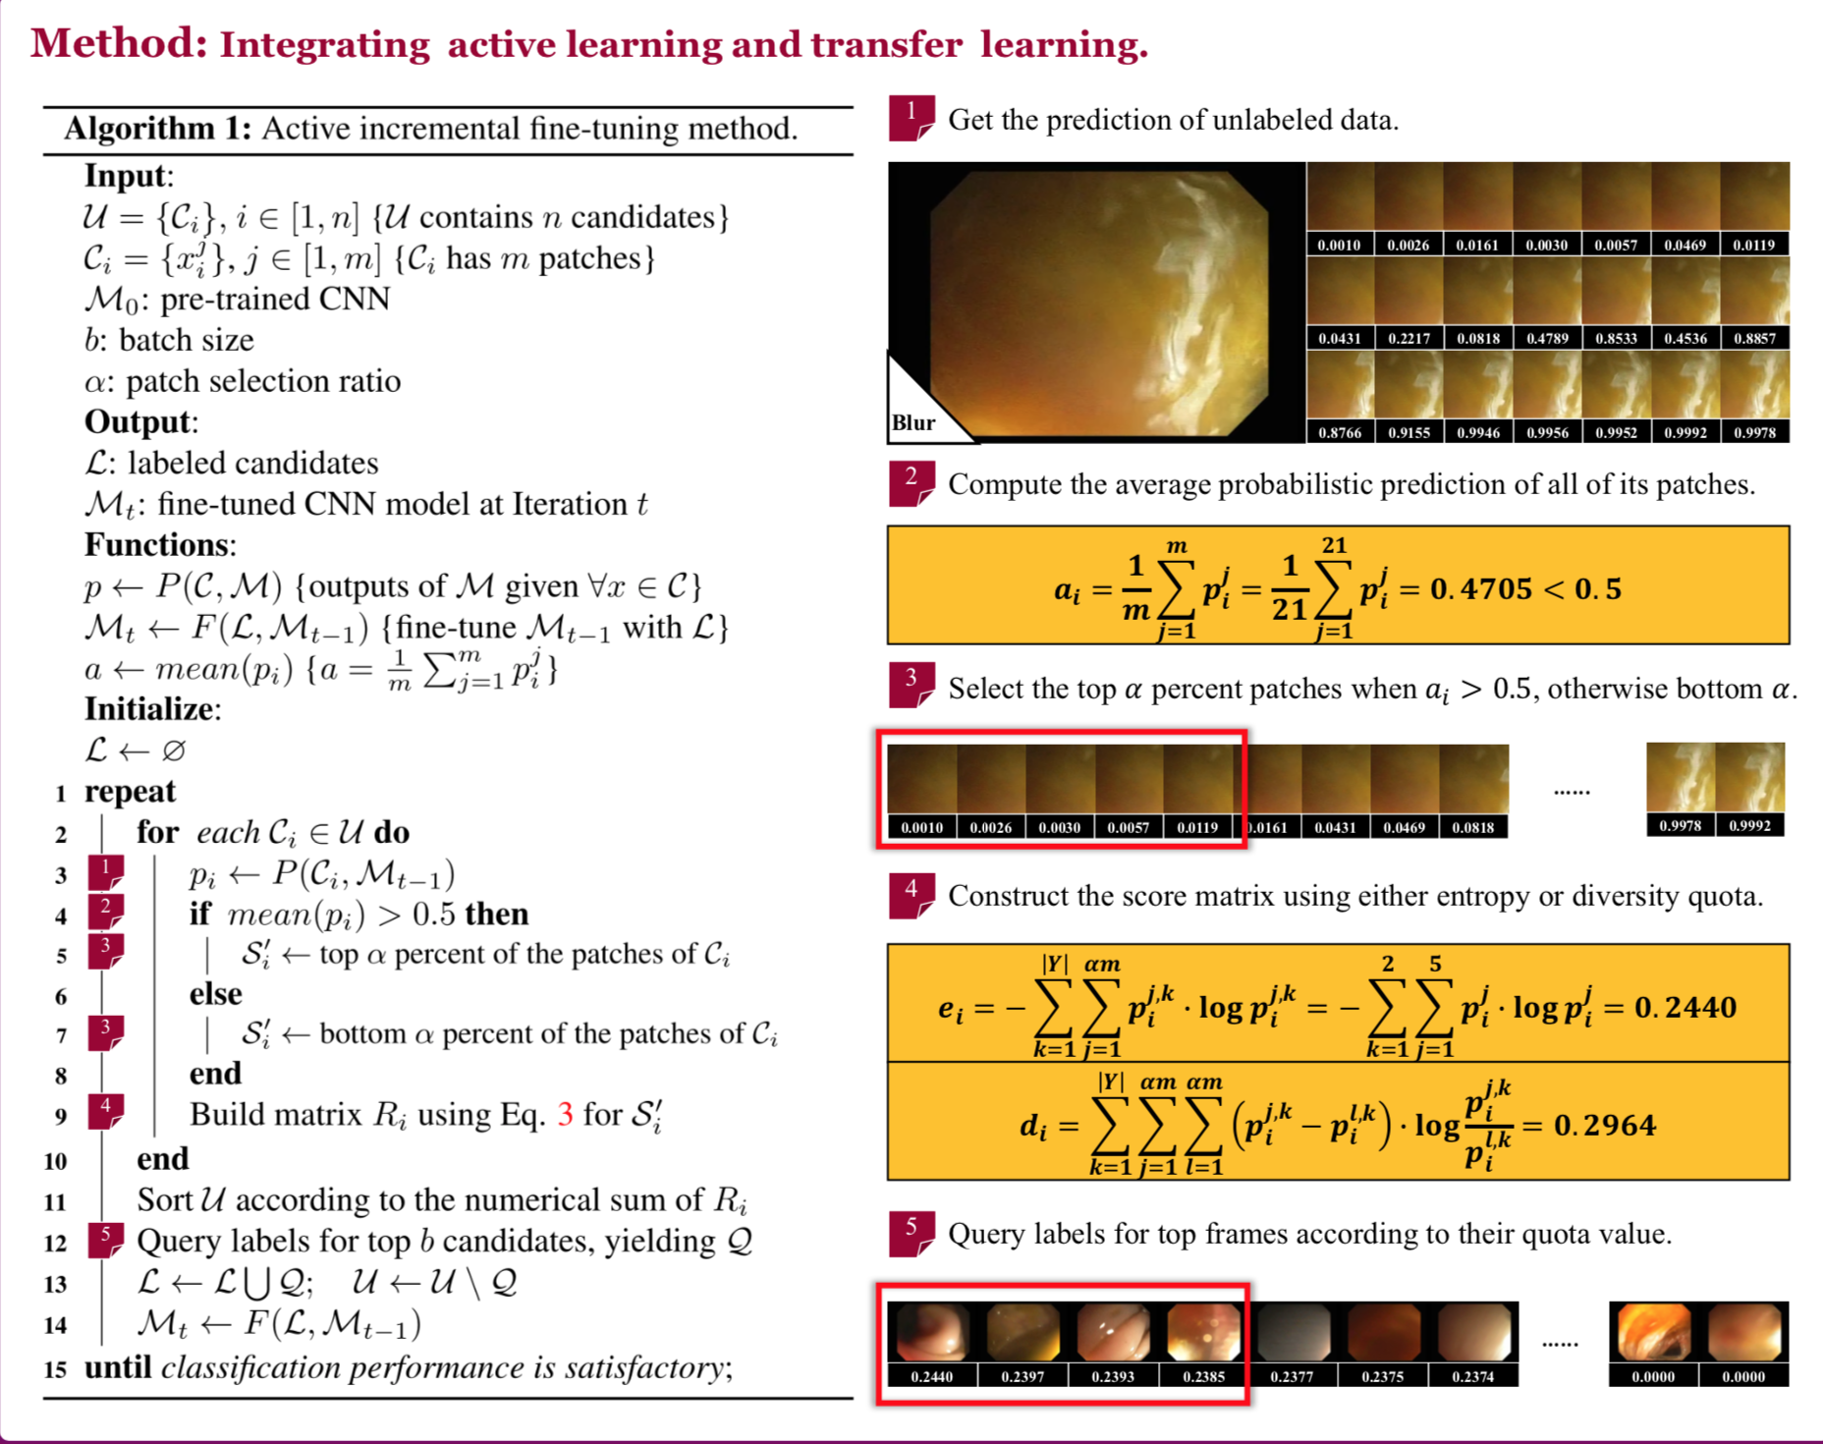
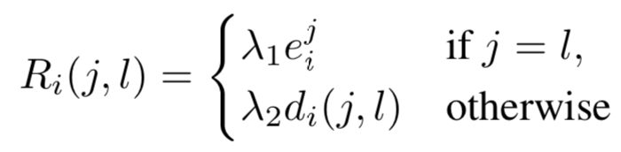
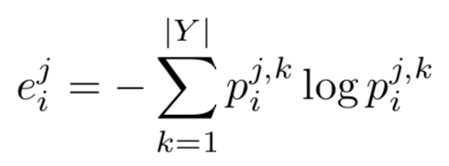
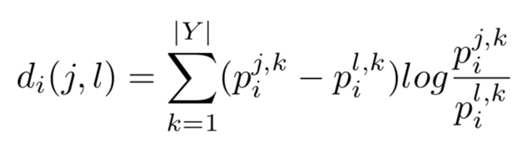
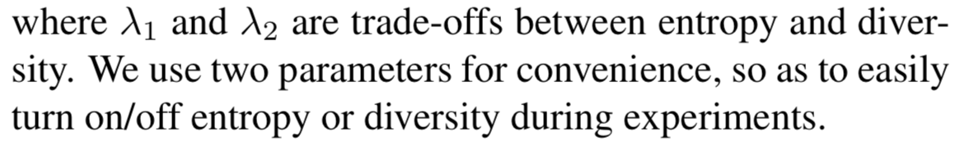
Handing noisy labels via majority selection

Slide 8
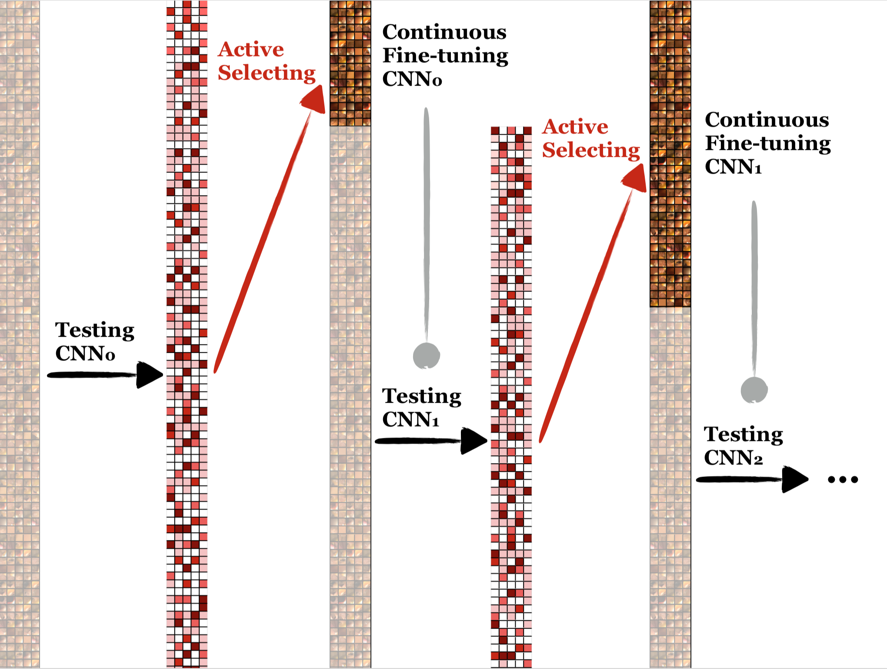

Slide 9
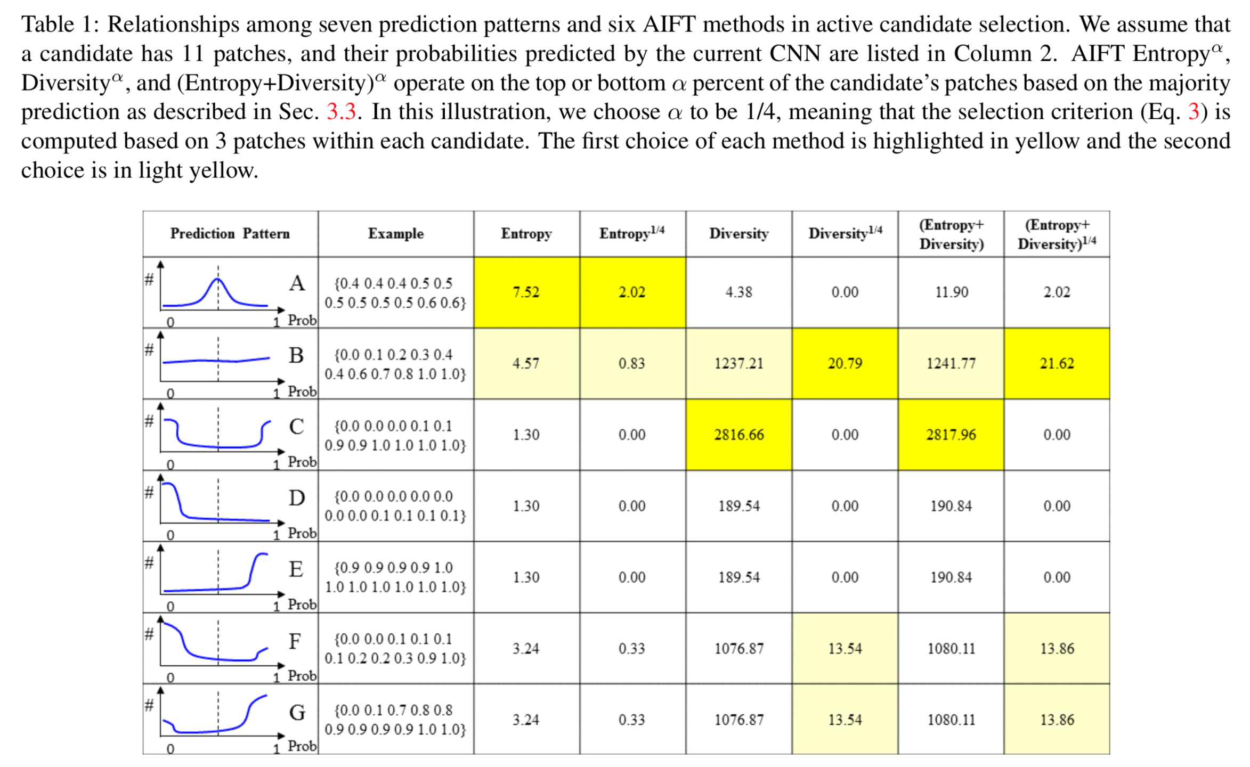
Notes:
Pattern A: The patches’ predictions are mostly concentrated at 0.5, with a higher degree of uncertainty.
Most active learning algorithms favor this type of candidate as it is good at reducing the uncertainty.
Pattern B: It is flatter than Pattern A, as the patches’ predictions are spread widely from 0 to 1, yielding a higher degree of inconsistency. Since all the patches belonging to a candidate are generated via data argumentation, they (at least the majority of them) are expected to have similar predictions. This type of candidate has the potential to contribute significantly to enhancing the current CNN’s performance.
Pattern C: The patches’ predictions are clustered at both ends, resulting in a higher degree of diversity. This type of candidate is most likely associated with noisy labels at the patch level, and it is the least favorable in active selection because it may cause confusion in fine-tuning the CNN.
Patterns D and E: The patches’ predictions are clustered at one end (i.e., 0 or 1) with a higher degree of certainty. The annotation of these types of candidates at this stage should be postponed because the current CNN has most likely predicted them correctly; they would contribute very little to fine-tuning the current CNN. However, these candidates may evolve into different patterns worthy of annotation with more fine-tuning.
Patterns F and G: They have higher degrees of certainty in some of the patches’ predictions and are associated with some outliers in the patches’ predictions. These types of candidates are valuable because they are capable of smoothly improving the CNN’s performance. Though they may not make significant contributions, they should not cause dramatic harm to the CNN’s performance.

Slide 10
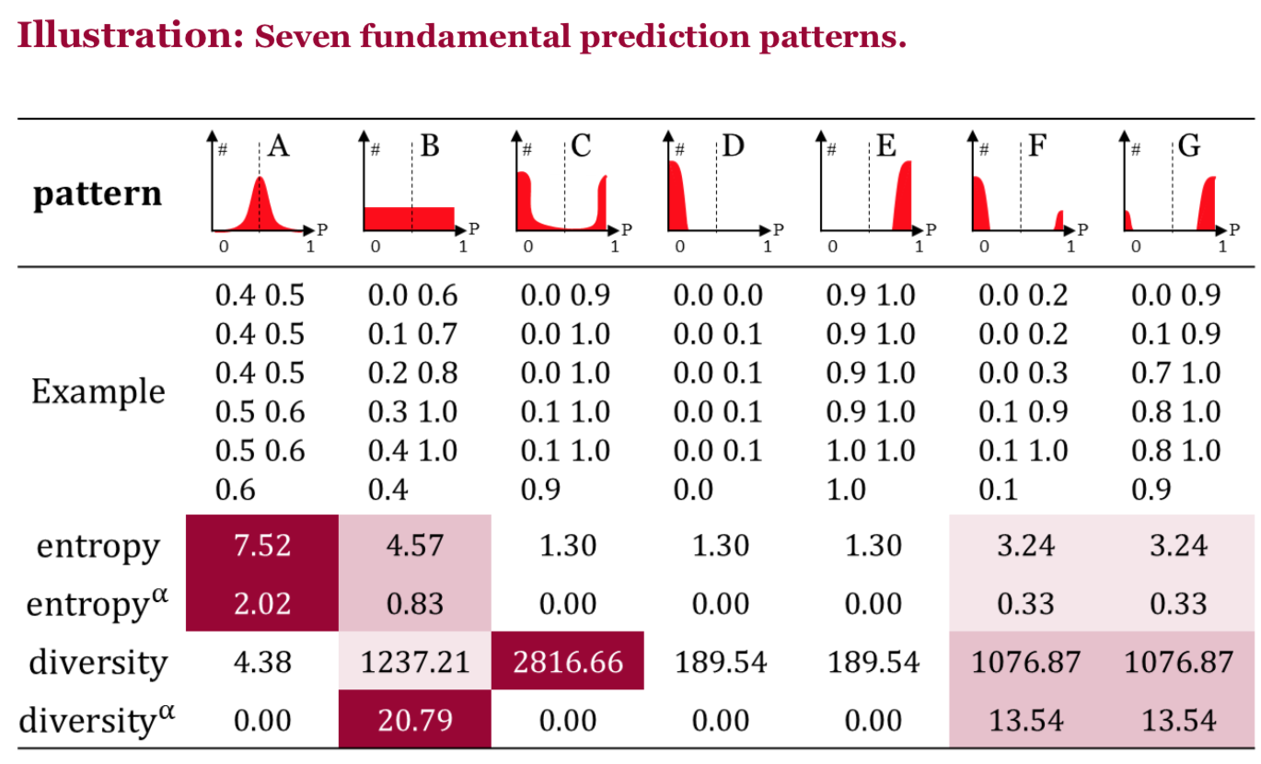
1. Patterns A and B are dominant in the earlier stages as the CNN has not been fine-tuned properly to the target domain.
2. Patterns C, D and E are dominant in the later stages of AIFT as the CNN has been largely fine-tuned on the target dataset.
3. The majority selection is effective in excluding Patterns C, D, and E.
4. prefers Pattern B while Diversity prefers Pattern C. This is why AIFT Diversity may cause sudden disturbances in the CNN's performance.
5. Patterns B, F, and G generally make good contributions to elevating the current CNN's performance.

Slide 11
Application：
Three different applications:
colonoscopy frame classification
polyp detection
pulmonary embolism (PE) detection.
The AIFT algorithm is implemented in the Caffe framework based on the pre-trained AlexNet model.
Evaluate six variants of AIFT (active incremental fine-tuning):
Diversity^{1/4} (using diversity on 1/4 of the patches of each candidate)
Diversity (using diversity on all the patches of each candidate)
Entropy^{1/4}
Entropy
(Entropy + Diversity)^{1/4}
(Entropy + Diversity)
Compare with:
IFT Random (incremental fine-tuning with random candidate selection)
Learning from Scratch in terms of AUC (area under ROC curve).
https://developers.google.com/machine-learning/crash-course/classification/roc-and-auc

Slide 12
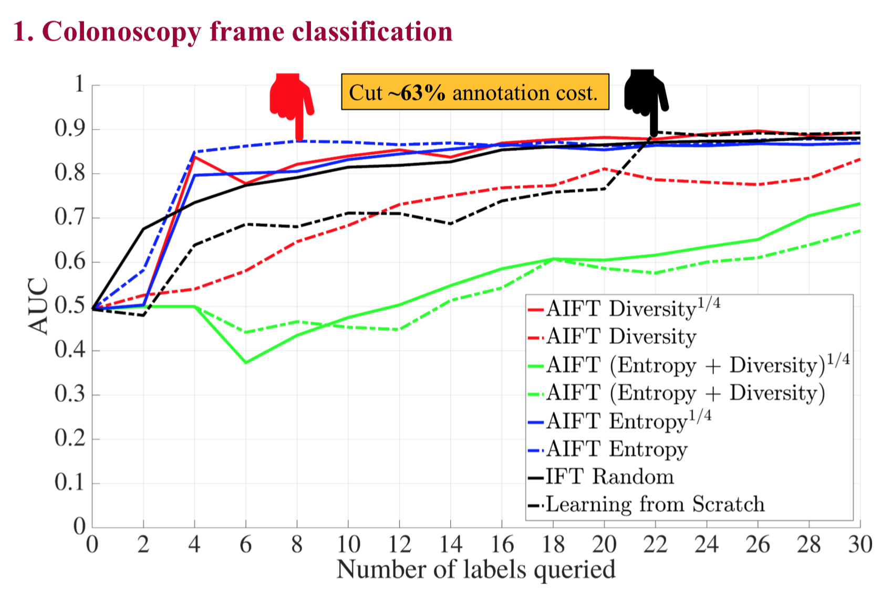
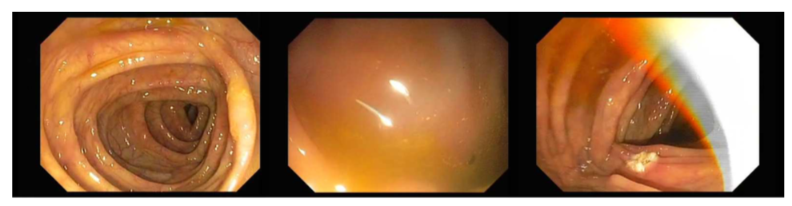
Colonoscopy frame classification:
4,000 colonoscopy frames are selected from 6 complete colonoscopy videos.
A trained expert then manually labeled the collected images as informative or noninformative.
The labeled frames separated into training and test sets, each containing approximately 2,000 colonoscopy frames.
For data augmentation, we extracted 21 patches from each frame.
Comparing 8 methods in colonoscopy frame classification.

Slide 13
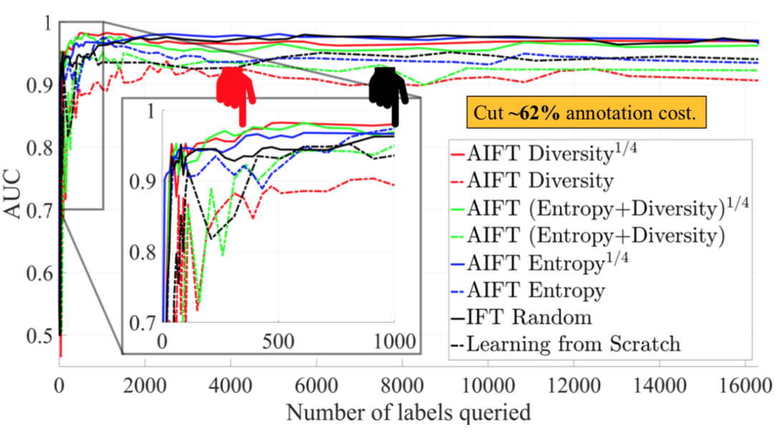
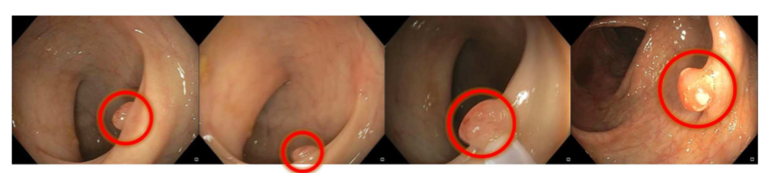
Polyp detection ：
The database contains 38 short colonoscopy videos from 38 different patients,
Separated into the training dataset (21 videos; 11 with polyps and 10 without polyps) and the testing dataset (17 videos; 8 videos with polyps and 9 videos without polyps).
16300 candidates and 11950 candidates were generated from the training dataset and testing dataset, respectively.
AIFT (Entropy + Diversity)^{1/4} and Diversity^{1/4} reach the peak performance with 610 label queries, while IFT Random needs 5711 queries, indicating that AIFT can cut nearly 90% of the annotation cost required by IFT Random.

Slide 14
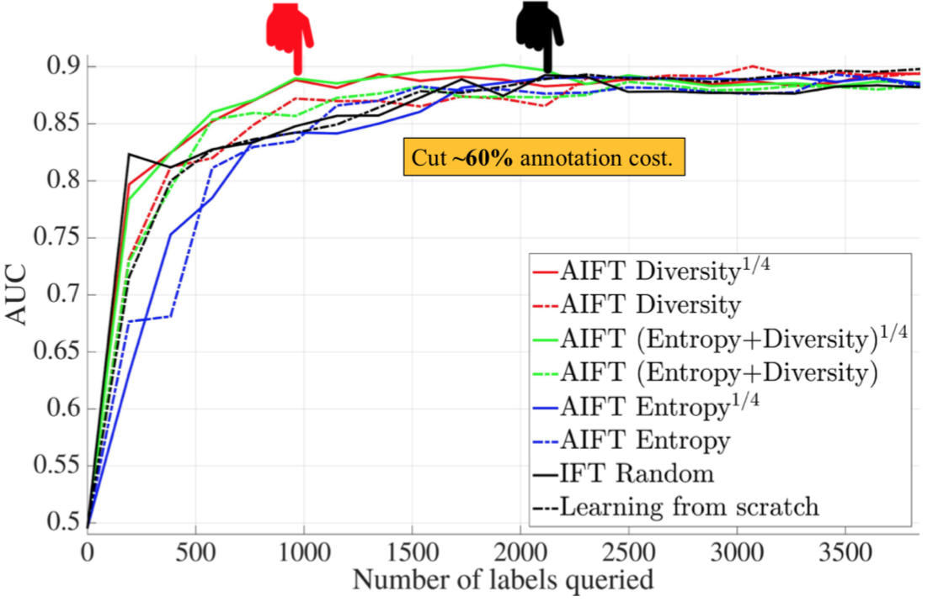
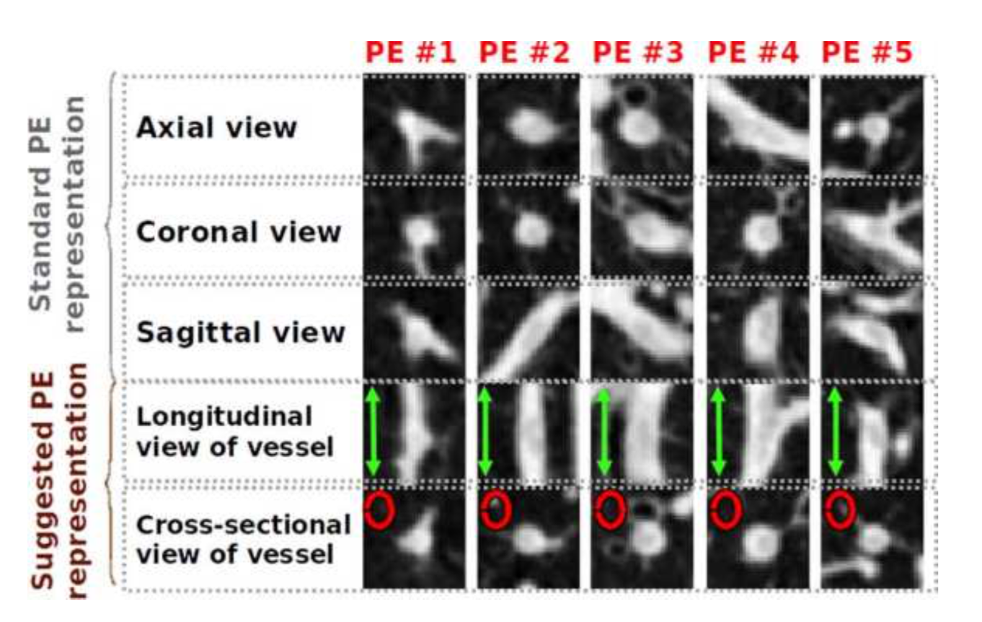
Pulmonary Embolism Detection :
For experiments, we use a database consisting of 121 CTPA datasets with a total number of 326 PEs.
A stratified training dataset with 434 true positive PE candidates and 3406 false positive PE candidates
A testing dataset with 253 true positive PE candidates and 2162 false positive PE candidates.
AIFT (Entropy + Diversity)^{1/4} and Diversity^{1/4} converge the fastest among the 8 methods and yields the best overall performance, attributed to majority selection method proposed in this work.

Slide 15
Advantages:
1. Starting with a completely empty labeled dataset.
2. Incrementally improving the learner through continuous fine-tuning rather than repeatedly re-training.
3. Naturally exploiting expected consistency among the patches associated for each candidate to select samples “worthy” of labeling.
4. Automatically handling noisy labels as only a portion of the patches in each candidate participates in the selection process.
5. Computing entropy and diversity locally on a small number of patches within each candidate, saving computation time considerably.

Slide 16
Thanks!
Reference:
http://openaccess.thecvf.com/content_cvpr_2017/papers/Zhou_Fine-Tuning_Convolutional_Neural_CVPR_2017_paper.pdf
https://github.com/MrGiovanni/Active-Learning
https://docs.wixstatic.com/ugd/deaea1_c21a4361487244efba9da9d84feddc72.pdf

